Slide 1

Final Project
Yoel Marquez, February 20, 2024, CS- 250

Slide 2
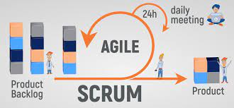
The power of Agile
Teams fluidity and adaptability
Communication and user stories drive efficiency
Ability to handle changes effectively

Slide 3
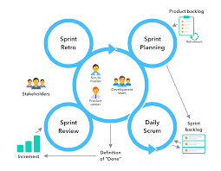
Key Scrum Roles
Scrum Master: Facilitator, guider, problem - solver
Product Owner: Customer / Stakeholder communicator
Developer: Technical implementation, programmer, versatile
Tester: Quality assurance

Slide 4
Key Phases
Sprint Planning: Define goals, create user stories
1
Sprint execution: Daily scrum, development, testing
2
Sprint review
3
Sprint retrospective: Team reflection, watch for areas of improvement.
4

Slide 5
Difference from Waterfall
Inability to change
Planning all done upfront
Tight restricted schedule
Lack of communication

Slide 6
Choosing the right Approach
Pick agile (duh)
Allow communication
Allow change
Promote fluidity and effectiveness

Slide 7
Work Cited
* What are the phases of Scrum?. Project Management Software for Marketing l Workamajig. (n.d.). https://www.workamajig.com/blog/scrum-methodology-guide/scrum-phases#:~:text=Scrum%20is%20an%20Agile%20project,and%20retrospective%2C%20and%20release%20phase.

